Slide 1

Advanced Calculator
A GUI-based Advanced Calculator developed using Python and Tkinter, demonstrating fundamental programming and GUI design principles.
Technology
Developer
Python
Adiesh Koul

Slide 2

Problem Statement
Traditional calculators often lack the flexibility for customization and advanced functionality, limiting their utility as a learning tool.
This project addresses this by creating a highly customizable, GUI-based calculator. It serves as an excellent demonstration of Python programming, GUI design principles, and effective event handling.

Slide 3
Project Objectives: Building a Smart Calculator
1
2
3
Interactive Design
Tkinter Implementation
Operation Range
Design an intuitive and interactive calculator interface using Python.
Implement the Graphical User Interface entirely using the Tkinter framework.
Perform both basic arithmetic and advanced mathematical operations.
4
5
Robust Error Handling
Scalability & Extensibility
Implement graceful handling for invalid user inputs and edge cases.
Create an application that is easy to scale and extend with new features.

Slide 4

Core Technology Stack
The advanced calculator is built on a robust and widely used set of technologies, ensuring reliability and ease of development.
Programming Language
GUI Framework
Libraries Used
Development Environment
Python 3: The backbone of the calculator's logic and functionality.
Tkinter: For creating the interactive and user-friendly graphical interface.
Math Essential for advanced mathematical operations.
VS Code / PyCharm: Popular IDEs facilitating efficient coding and debugging.

Slide 5
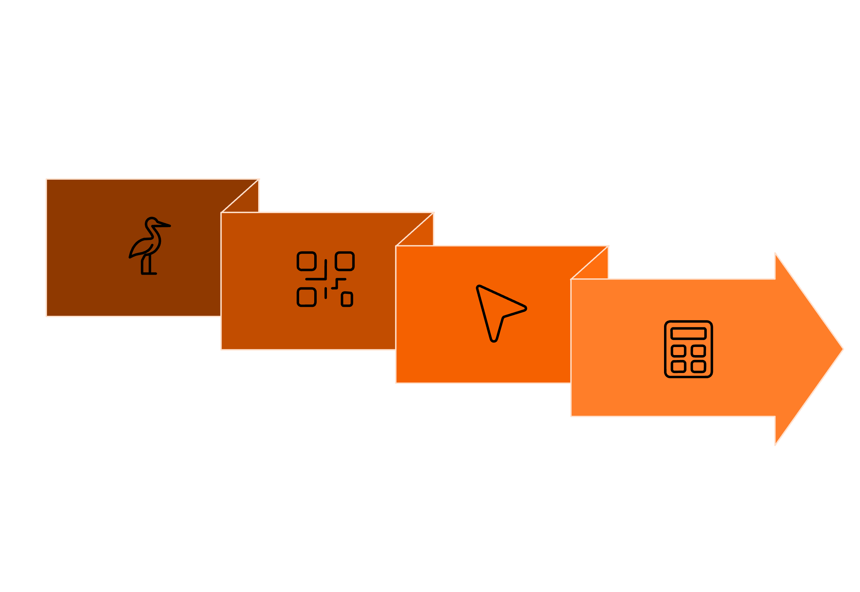
System Architecture Overview
Backend Logic
Computation Engine
Frontend
Event Handling
The calculator's architecture is segmented into clear, interconnected layers, ensuring modularity and efficient processing from user input to final result.

Slide 6


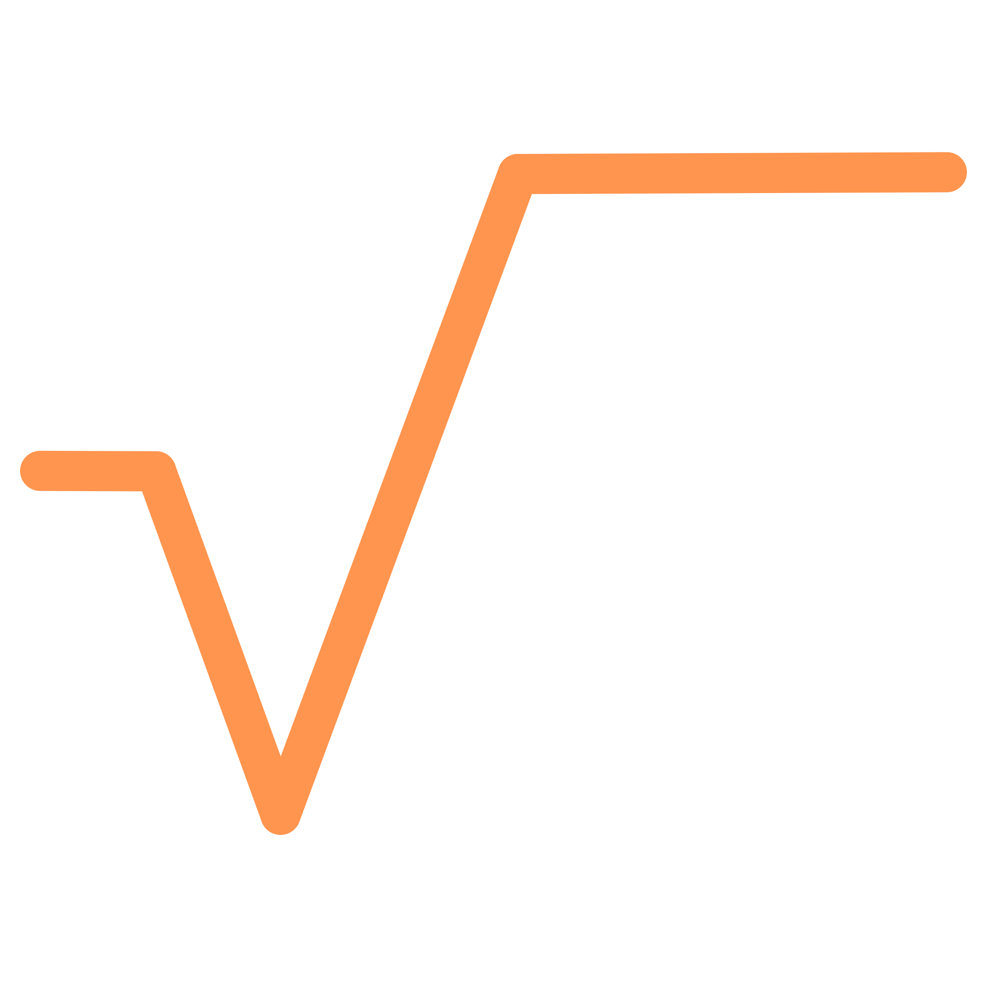

Key Functional Features
This calculator provides a comprehensive set of operations, catering to both everyday calculations and more complex mathematical needs.
Arithmetic Operations
Advanced Functions
Perform fundamental calculations: Addition (+), Subtraction (−), Multiplication (×), and Division (÷).
Compute powers like Square (x²) and Cube (x³).
Mathematical Functions
Utility Functions
Access functions such as Square Root (√) and Reciprocal (1/x).
Efficiently manage inputs with Clear (C) and Backspace (⌫) options.

Slide 7
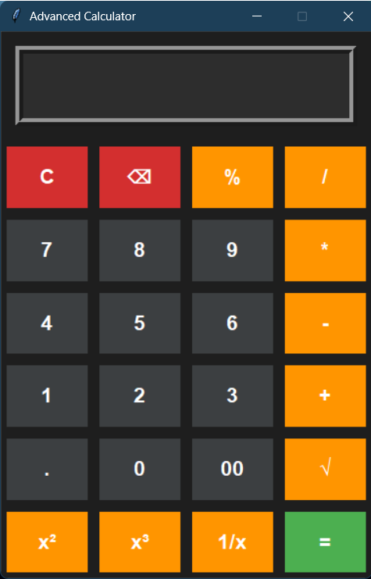
User Interface Design: Intuitive and Responsive
The user interface is crafted for ease of use, combining aesthetic appeal with practical functionality to enhance the user experience.
Clean and Minimal Layout: A clutter-free design ensures focus on calculations.
Large Input/Output Display: Clear visibility of numbers and results at all times.
Grid-based Button Alignment: Ensures a responsive and organized layout for all buttons.
User-Friendly & Intuitive: Designed to be easily understood and operated by anyone.

Slide 8
Program Workflow: Step-by-Step Calculation
Understanding the sequential flow of operations is key to appreciating the calculator's underlying logic.
01
02
03
Input Values
Display Input
Trigger Functions
User enters numbers and operations via the interactive GUI buttons.
The entered input is immediately shown in the calculator's Entry widget.
Each button click initiates specific functions corresponding to its operation.
04
05
Process Calculation
Display Result
The internal computation engine evaluates the expression using Python's eval() and math functions.
The final result or an appropriate error message is presented to the user.

Slide 9
Robust Error Handling & Validation
Ensuring application stability and a smooth user experience, even when unexpected inputs occur, is paramount.
Exception Prevention
Invalid Expression Management
Utilizes try-except blocks to gracefully manage errors and prevent application crashes.
Effectively handles mathematically incorrect expressions, guiding the user.
User-Friendly Messages
Division by Zero Safeguard
Displays clear and concise 'Error' messages for easier troubleshooting.
Specifically prevents and flags attempts to divide by zero, a common calculation error.

Slide 10

Conclusion & Future Enhancements
This project stands as a testament to the power of Python and Tkinter in creating functional and user-friendly GUI applications.
Conclusion
Future Scope
Integrate advanced scientific functions (sin, cos, log, etc.).
Add support for direct keyboard input for faster operation.
Introduce a dark mode UI for improved aesthetics and reduced eye strain.
Package the application into a standalone executable (.exe) file.
Successfully demonstrates seamless integration of Python GUI and logic.
An excellent tool for academic study and learning Python GUI development.

